Slide 1
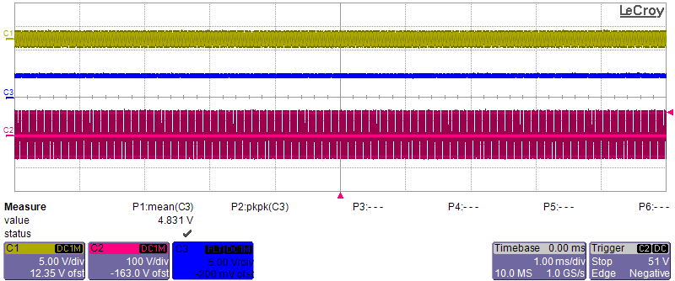
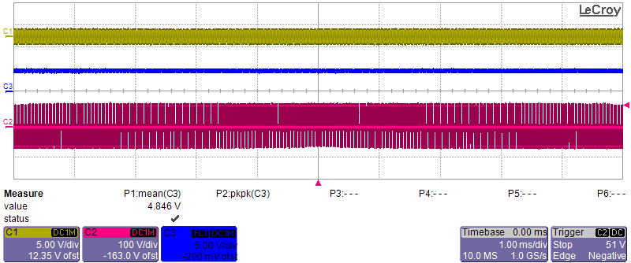
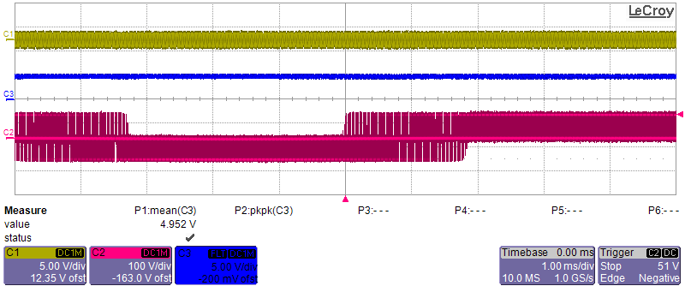
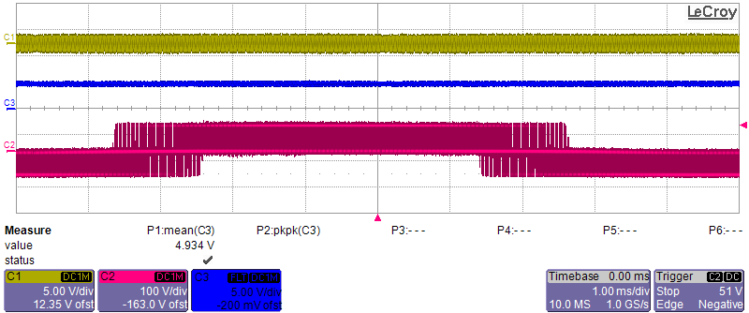


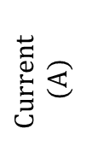

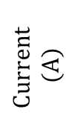
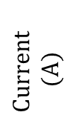
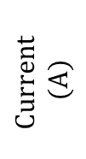
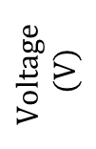
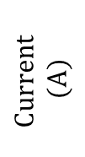
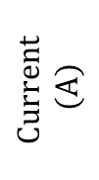

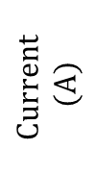


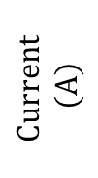

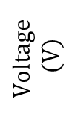
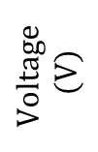
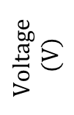
$$Current$$
$$(A)$$
$$Current$$
$$(A)$$
(a)
$$Current$$
$$(A)$$
$$Current$$
$$(A)$$
$$Voltage$$
$$(V)$$
$$Voltage$$
$$(V)$$
$$Time (μs)$$
$$Current$$
$$(A)$$
(b)
$$Current$$
$$(A)$$
$$Voltage$$
$$(V)$$
$$Time (μs)$$
$$Current$$
$$(A)$$
(c)
$$Current$$
$$(A)$$
$$Voltage$$
$$(V)$$
$$Time (μs)$$
$$Current$$
$$(A)$$
(d)
$$Current$$
$$(A)$$
$$Voltage$$
$$(V)$$
$$Time (μs)$$

Slide 2
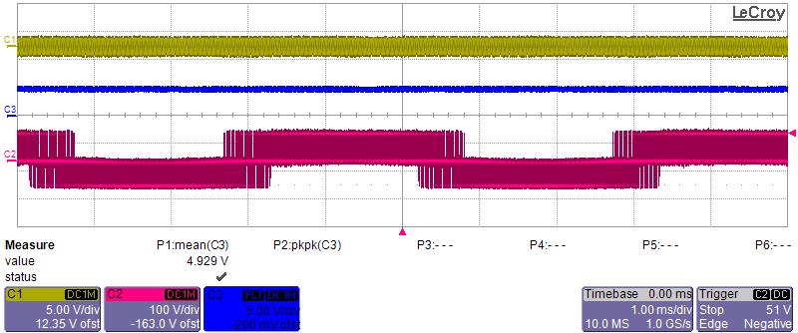
(a)
(b)

Slide 3
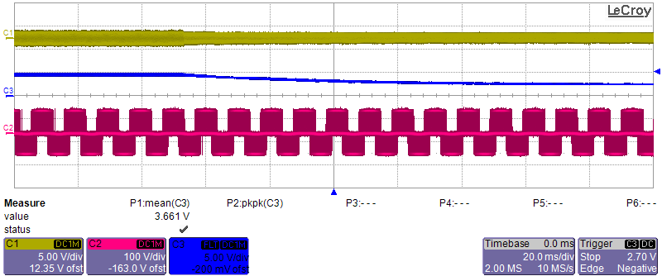


$$f_{s}=60 kHz$$
$$f_{s}=62 kHz$$

Slide 4
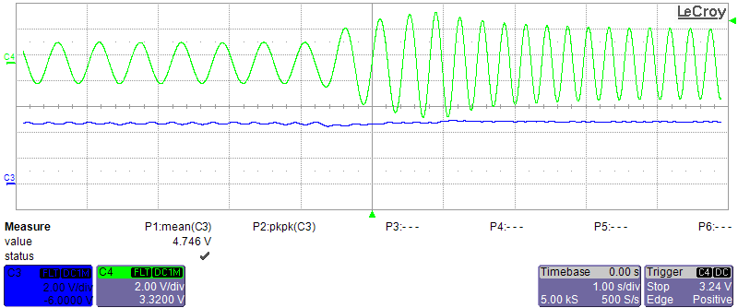





Motor speed:
$$52 RPM$$
Motor speed
$$increases$$
Motor speed:
$$101 RPM$$
$$I_{F}=4.7 A$$
$$I_{F}=4.8 A$$

Slide 5
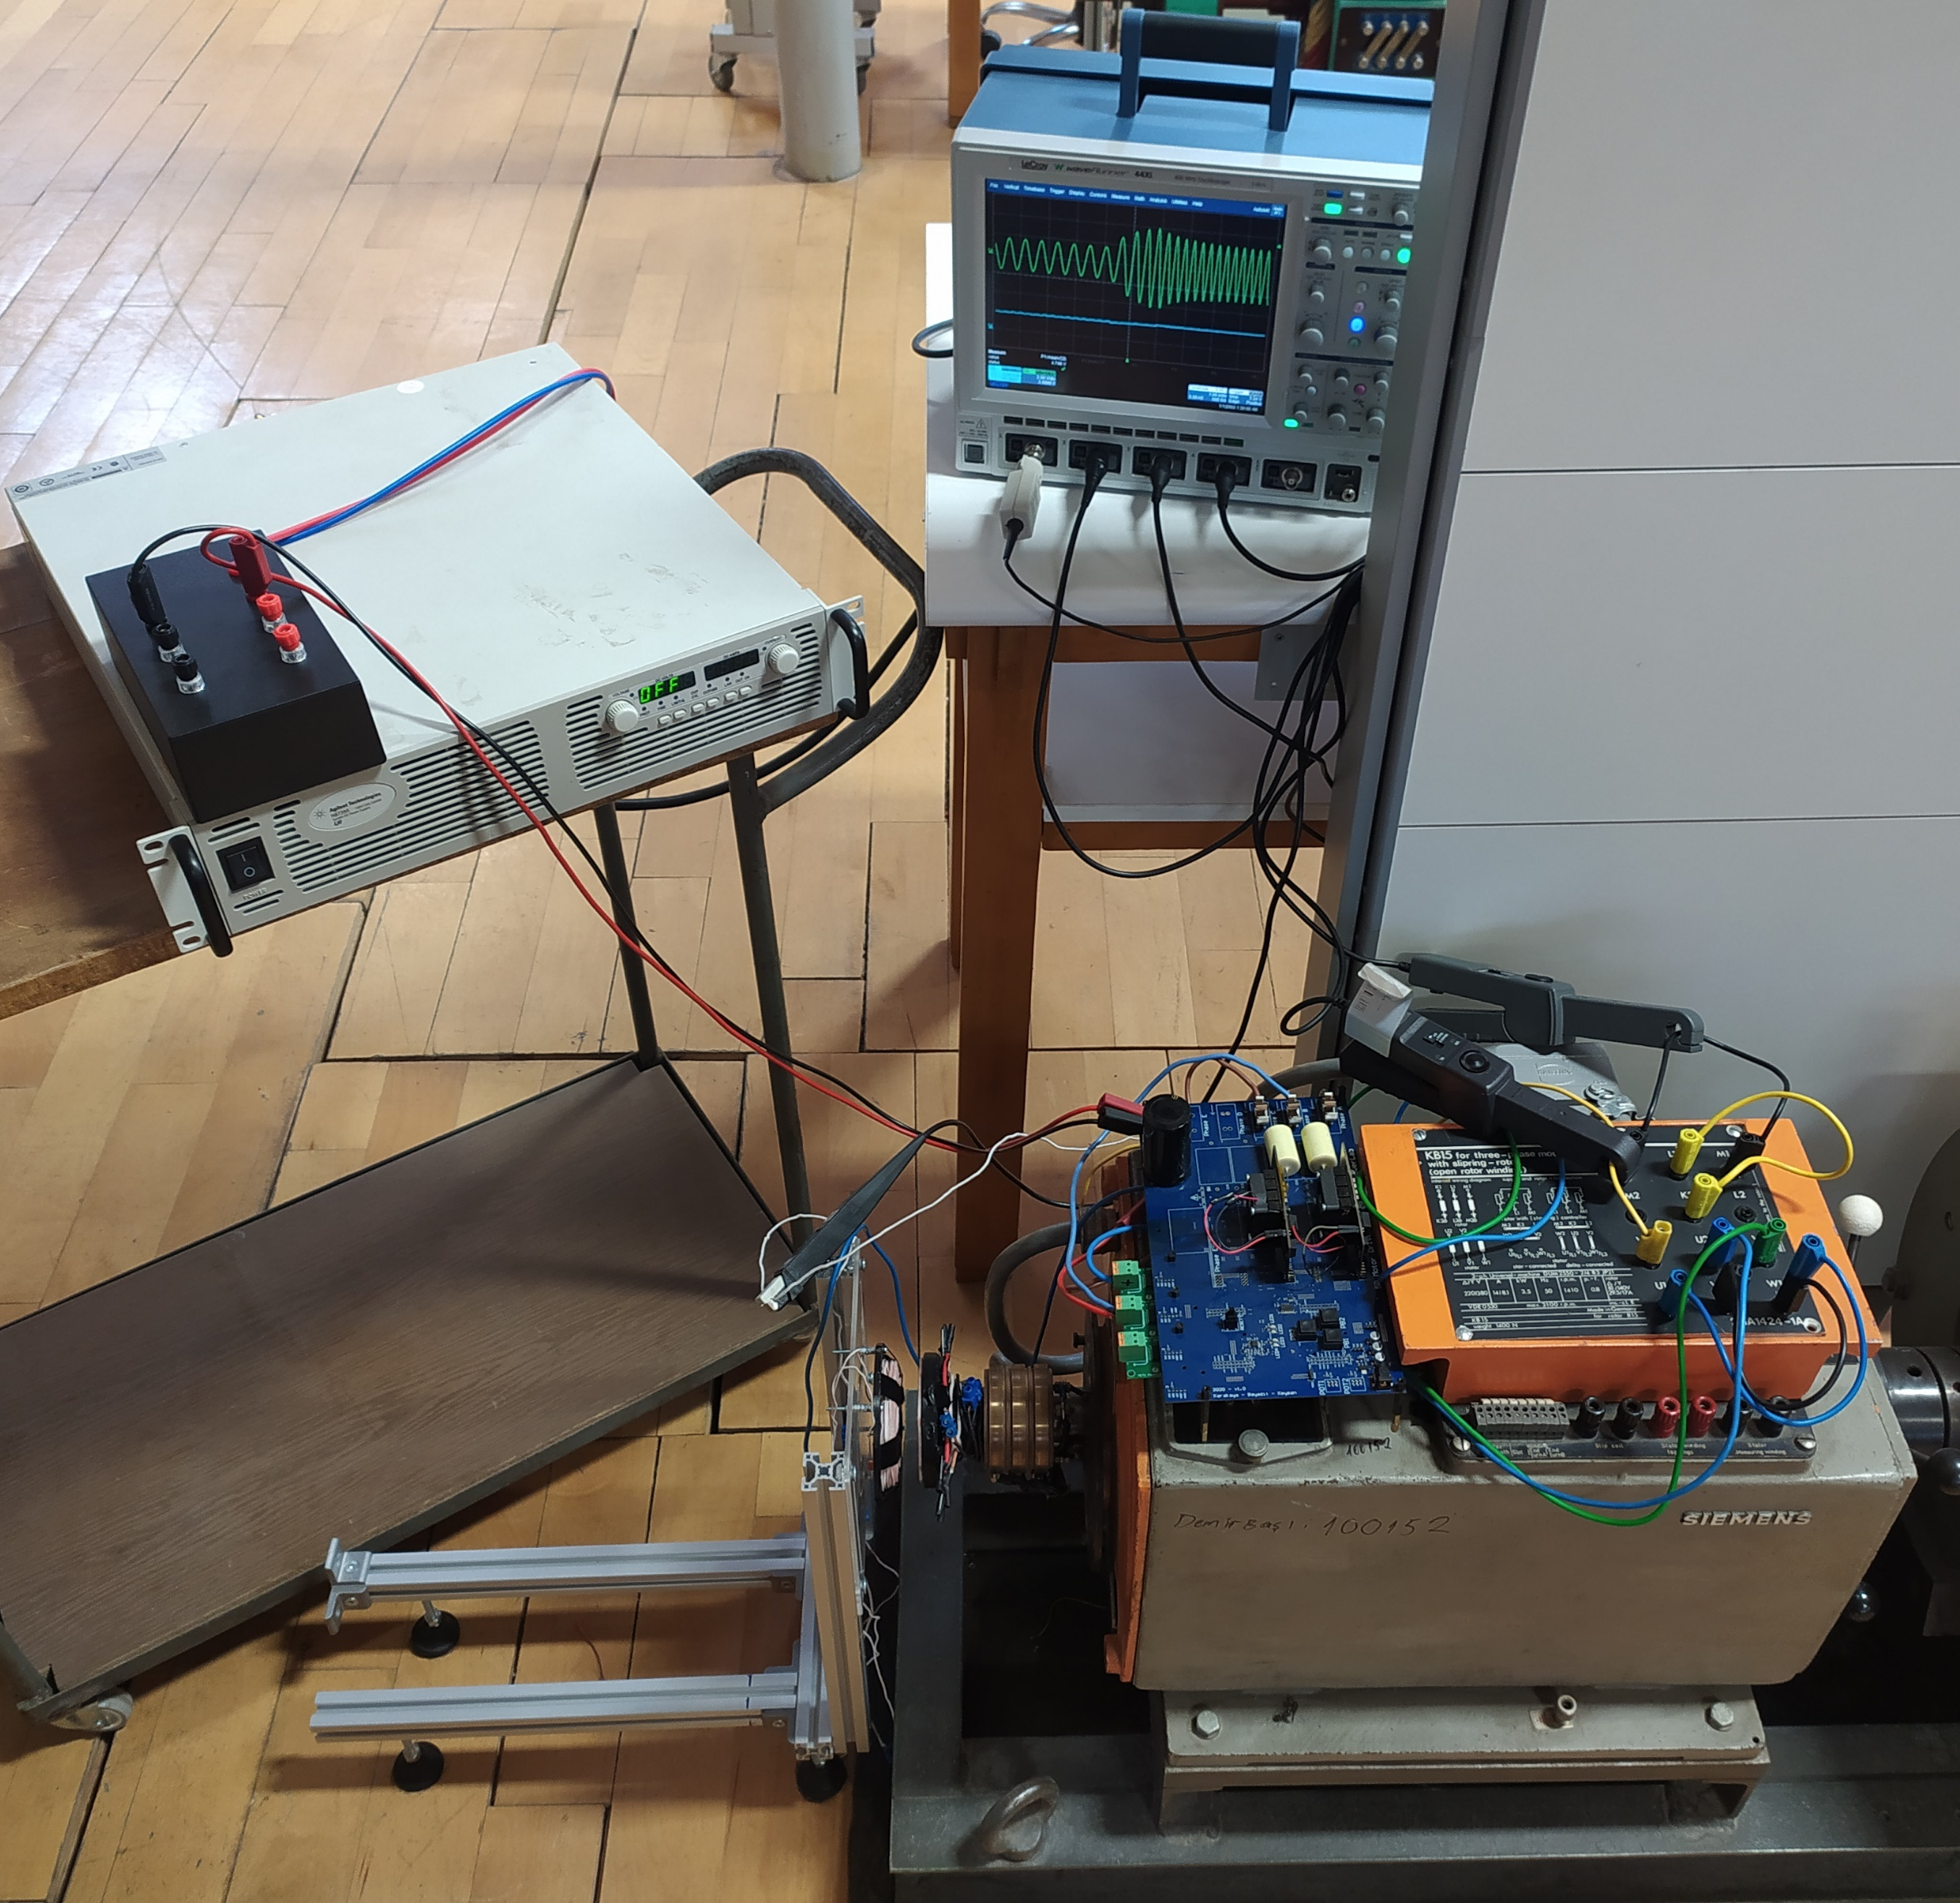
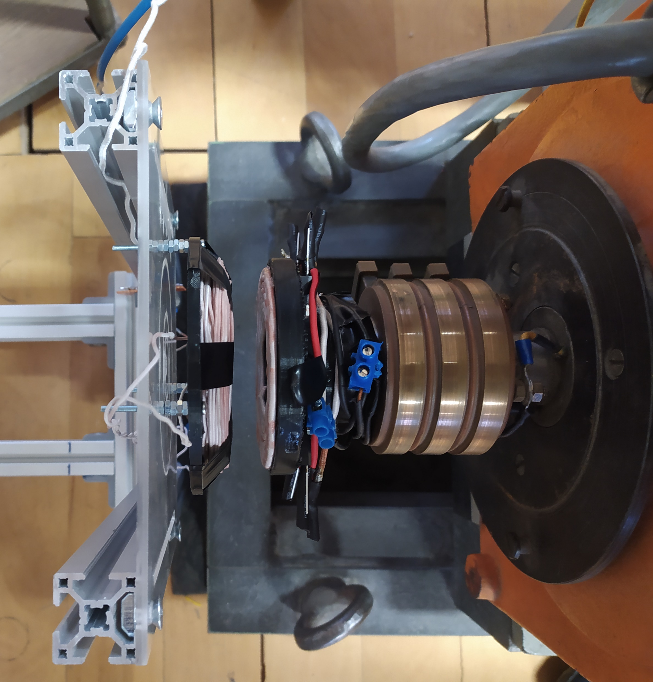
Oscilloscope
Stationary
Tx coil
Rotating Rx coil
Rotating diode rectifier
Motor drive
Current probes
Current probe
DC supply
Contactless field excitation system
(b)
Electrically excited synchronous motor
(a)

